Slide 1
Inheritance Vs Composition

Slide 2
Inheritance versus Composition
Most common OOP reusing techniques
Inheritance
Composition

Slide 3
Class inheritance
Implements one class in terms of other
Parent is visible to child - White box reuse
Class can derived from another class that is called super class (parent class) and the derived class is called as sub class (child class).
Child class inherits the attributes of its parent class.
Child class can use attributes of parent as if they were defined in the child class.
A child class can also override data members and methods from the parent.
Overriding implements special or different functionality in subclass.

Slide 4
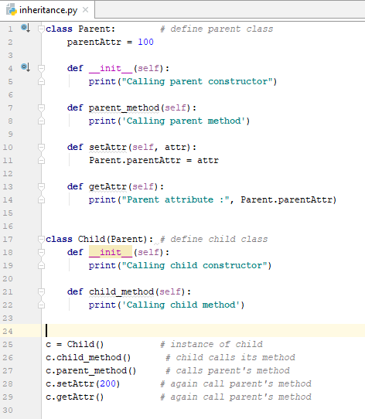
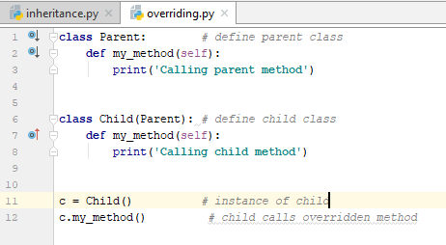
Class Inheritance - Example

Slide 5
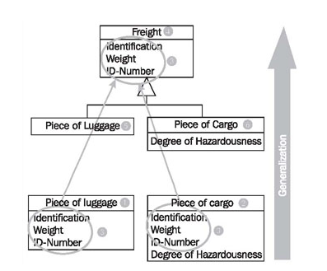
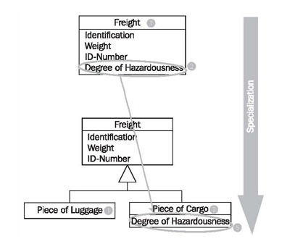
Class Inheritance – Class Diagram

Slide 6
Class Inheritance - Advantages
Define statistically at run time
Straight forward to use
Supported directly by programming languages
Easy to modify the implementation
Sub class overrides some of the operations
It affects the operations it inherits

Slide 7
Class Inheritance - Disadvantages
Cannot change the implementation that inherited from parent class at run-time
Inheritance is defined at compile time
Parent class often defined at least part of sub class
Inheritance break encapsulation
Parent class may need to rewrite or replace
Limit flexibility and reusability

Slide 8
Object composition
Alternative to class inheritance
Create new functionalities using objects
Need well defined interfaces
More complex functionalities
Black box reuse
Internal details are not visible

Slide 9
Object composition - Advantages
Define dynamically at run-time
Objects acquire reference to other objects
Objects require to be respect each other’s interfaces
Objects are accessed through interfaces therefore Object composition does not break encapsulation
Object can be replace at run-time by another object
Fewer implementation dependencies
Object composition favour class inheritance therefore class encapsulate and focus on one task
Classes and class hierarchies will remain small and less likely to grow

Slide 10
Object composition - Advantages
If there are more objects, system behaviour will depend on interrelationship instead of being depend in one class. It leads second OOD principle.
Favour object composition over class inheritance

Slide 11
Object composition - Advantages
Object composition helps to create functionality using existing components
Inheritance and composition work together
Designers overuse inheritance as for reusing
Object composition make reuse simpler

Slide 12
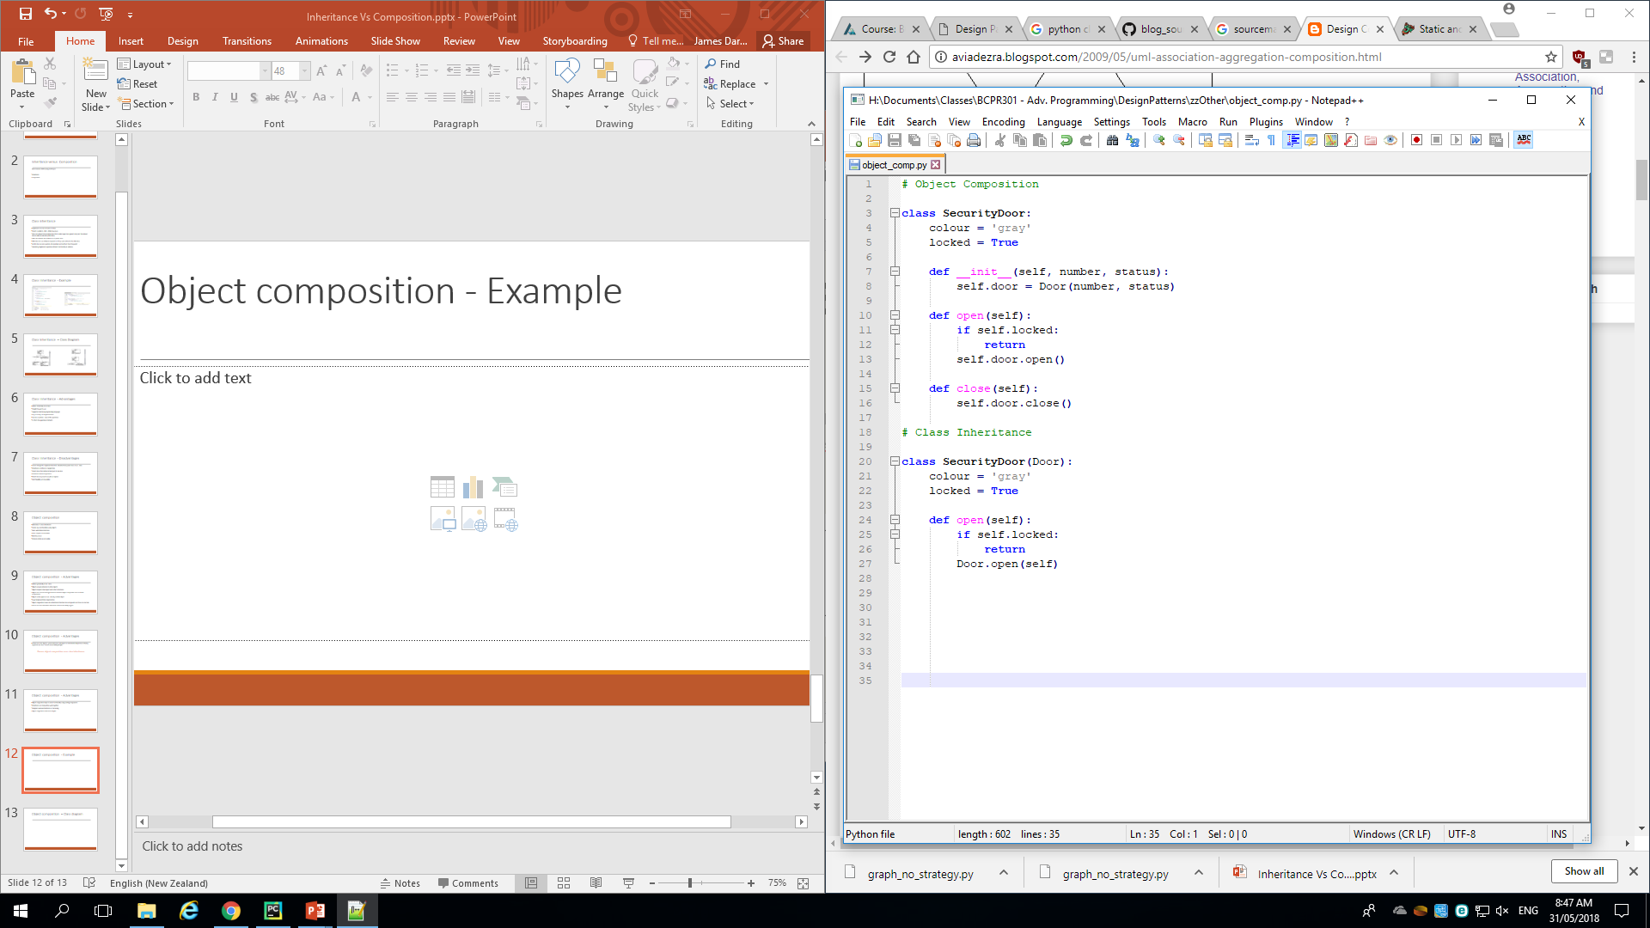
Object composition - Example

Slide 13
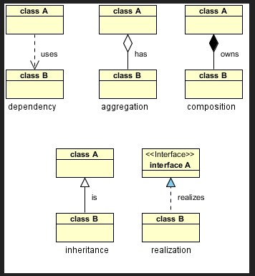
Object composition – Class diagram

